Slide 1
Characterization of Laser Energy Deposition for Active Flow Control
Clark Pederson
University of Arizona
Advisor: Dr. Jesse Little,
Assistant Professor, Department of Aerospace and Mechanical Engineering,
University of Arizona
Arizona Space Grant Consortium
April 12th, 2014
Tucson, AZ

Slide 2
Acknowledgements
NASA Space Grant Director: Susan Brew
NASA Space Grant Consortium
Research Group, including:
  Robyn Dawson
  Jared Hainsworth
Air Force Office of Scientific Research

Slide 3
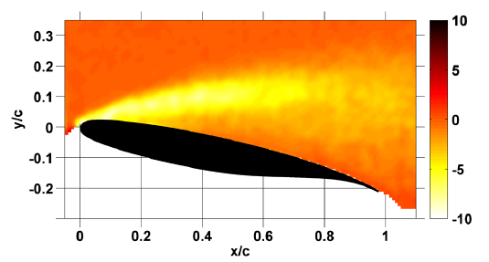
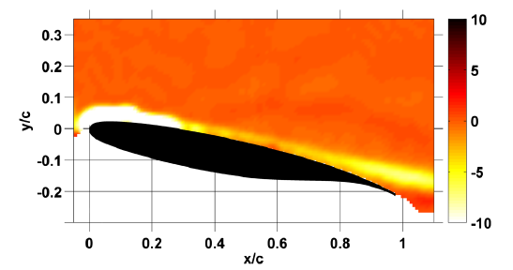
Background of Plasma Actuators
Plasma actuators use high voltage pulses to generate rapid localized near surface gas heating.
These actuators have proven successful in preventing stall on airfoils at high angle of attack.
Vorticity of an Airfoil without Plasma actuator
Vorticity of an Airfoil with Plasma actuator
Images from Little et al, 2012.

Slide 4
Brief Summary
Research Question: Can lasers be used in place of plasma plasma actuators for studies of thermoacoustic flow control mechanisms?
Lasers have some advantageous qualities in comparison to plasma actuators.
  Higher energy
  More capability for spatial variation
  Disadvantage is low frequency

Slide 5
Laser-Produced Plasmas
Shock waves from plasma actuators were compared to those generated by laser ablation.
The laser superheats an aluminum target, turning the surface of it into plasma.
Temperatures on the order of 900 K.
Laser Line
Shock Wave
Aluminum

Slide 6
Experimental Setup
Prism
Nd:YAG Laser
LED
Mirror
Spherical Lens
Cylindrical Lens
Concave Mirror
Concave Mirror
ICCD Camera
Aluminum Plate
Mirror
Knife Edge

Slide 7
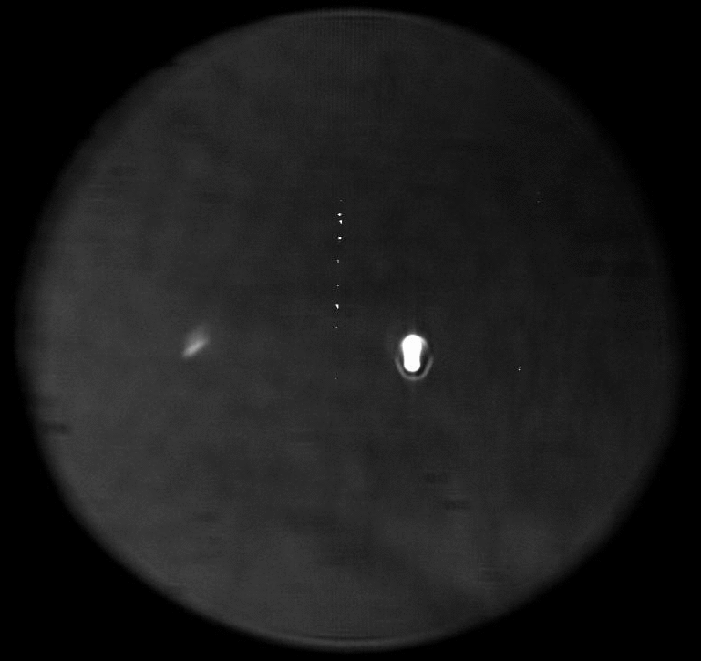
Schlieren Imaging
Schlieren imaging visualizes changes in density of the air.
Shock waves appear as lines in the air.

Slide 8
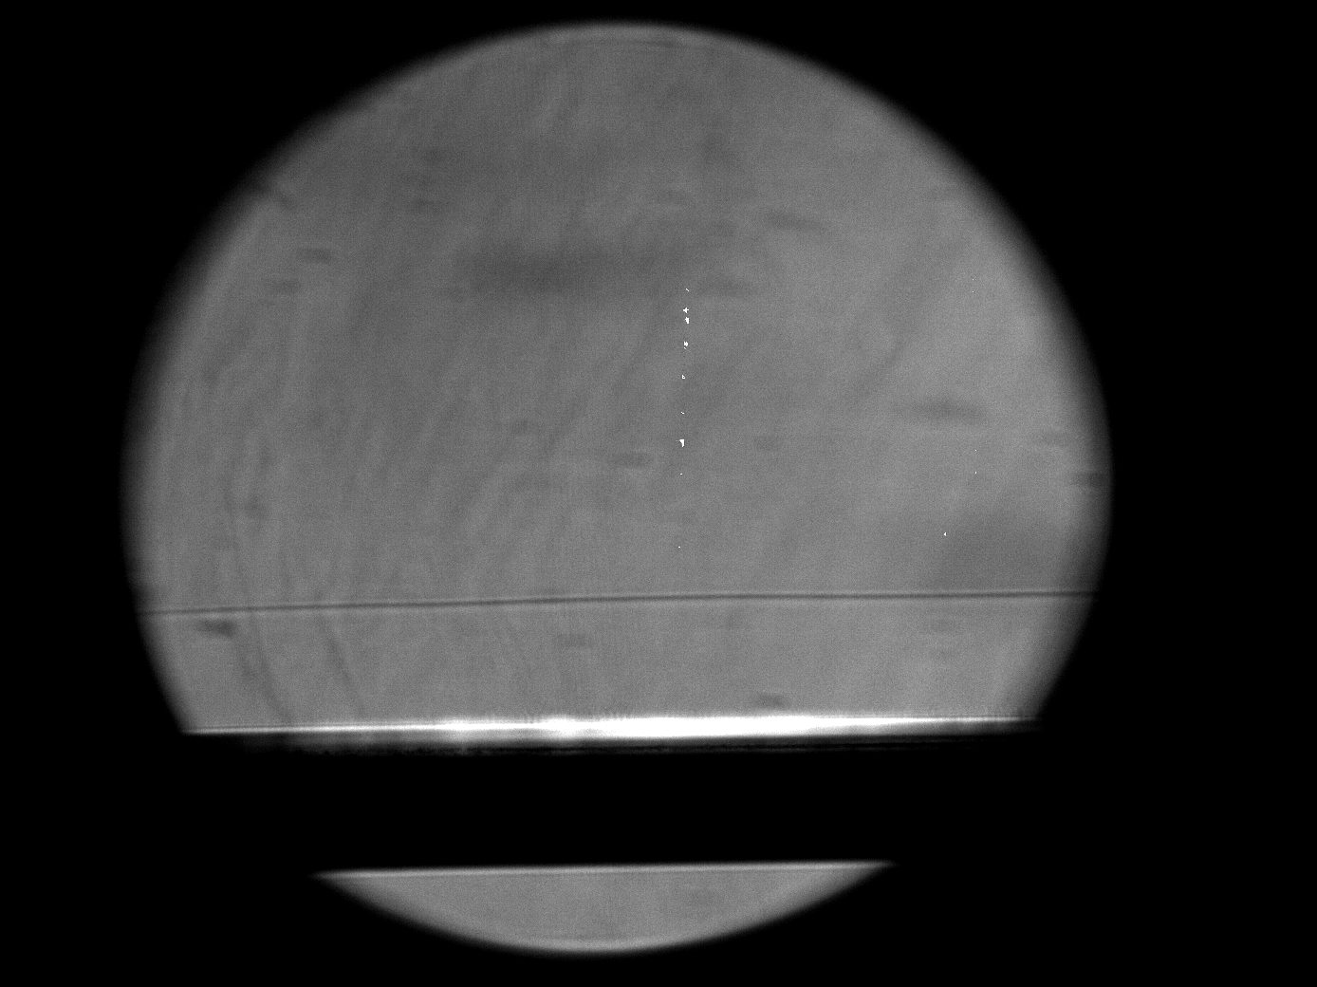
Image Analysis
A custom-made MATLAB program was used to analyze the images.
It located the position of the shocks
It qualitatively determined the strength of the shocks using the intensity of the lines.
Shock Wave

Slide 9
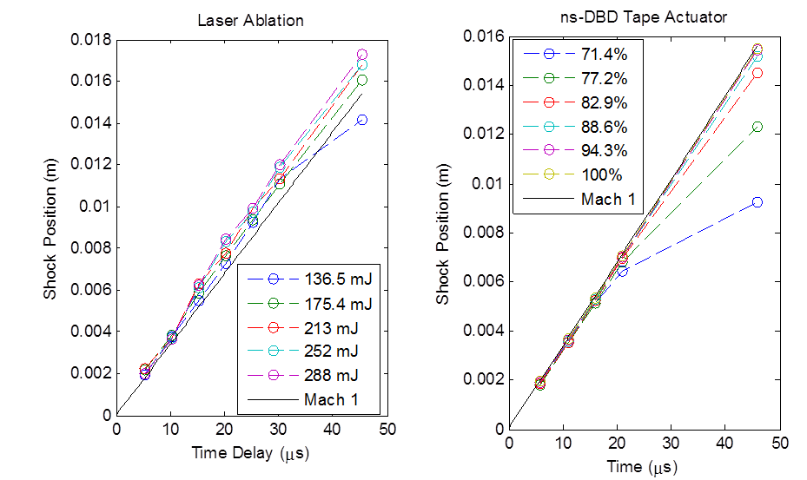
Results: Shock Speed

Slide 10
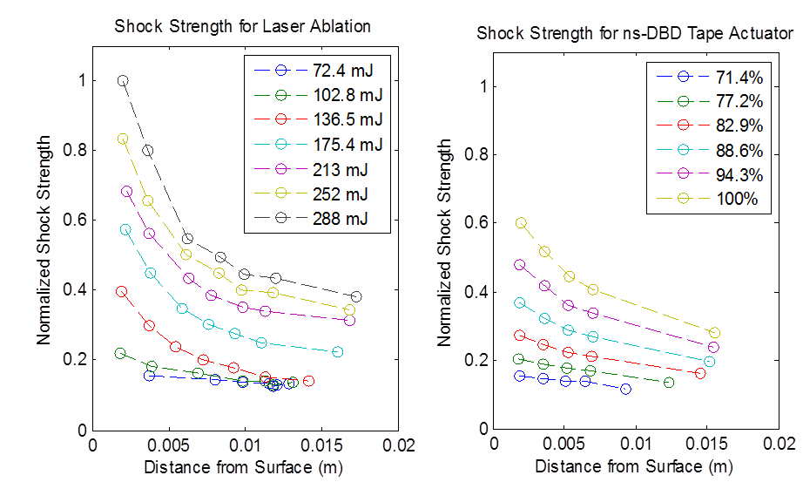
Results: Shock Strength

Slide 11
What’s Next?
These results confirm that the shock speeds are similar; both go to Mach 1 eventually.
Lasers produce stronger shocks.
Pulsed lasers can be used to approximate higher-power plasma actuators.
This allows future studies of flow control in wind tunnels with lasers in place of plasma actuators.

Slide 12
Thank you!

Slide 13
References
“Separation Control with Nanosecond-Pulse-Driven Dielectric Barrier Discharge Plasma Actuators,” Little, Jesse et. al, AIAA JOURNAL Vol. 50, No. 2, February 2012
“Characterization of nanosecond pulse driven dielectric barrier discharge plasma actuators for aerodynamic flow control,” Robert Dawson and Jesse Little, Journal of Applied Physics, 113 (2013), 103302
Image from http://www.sonorex.ca/world/files/physicians/shockwav.html

Slide 14
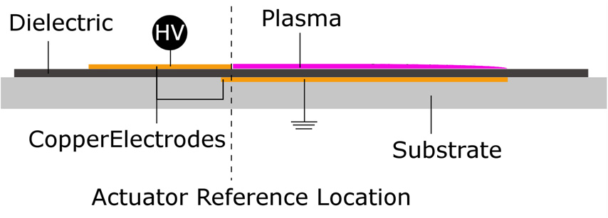
Plasma Actuators
Called ns-DBD (or Nanosecond-Pulse-Driven Dielectric Barrier Discharge) Plasma Actuators
These excite natural instabilities in flow.
Most commonly, they excite points of flow separation.
Detail of an Plasma Tape Actuator
Image from Dawson and Little, 2013

Slide 15
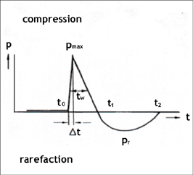
Schlieren Images
Image from Reference 3

